Slide 1
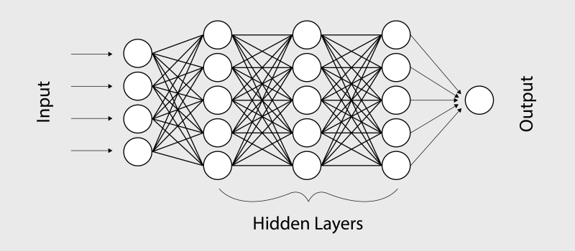
Applications of Deep Reinforcement Learning on Control Systems Environments
This Photo by Unknown Author is licensed under CC BY-NC-ND
Supervisor: Prof. Dr. rer. nat. André Grüning
Co-Supervisor: Prof. Dr. rer. nat. Christian Bunse

Slide 2
Structure
Background
Motivation
Experimental Setup
Research Methodology and Solution Strategy
Problem Statement
Results and Current Status
Notes:
Background
Motivation
Problem Statement
Research Methodology
Experimental Setup
Results and Current Status

Slide 3

Background Reinforcement Learning(RL)
Subsection of Machine Learning
Elements of RL
Policy – describes Agent’s behavior at a given time
Reward – Goodness at a given time
Value function– Estimates Goodness in the long run
Goal of Agent – Maximize cumulative Rewards
This Photo by Unknown Author is licensed under CC BY-SA-NC

Slide 4

Background Reinforcement Learning(RL)
Major Policy or Algorithms to solve RL problems
Deep Q Network
Policy Gradient
Major research by Google‘s DeepMind
This Photo taken from https://deepmind.com/blog

Slide 5

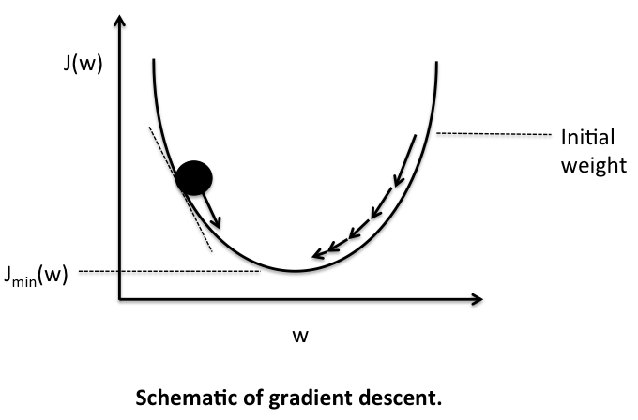
Motivation
Research related
Lack prior guidelines for choice of algorithm
How to apply these algorithms or policies on different environment?
Analyze which algorithm works better in a particular environment?
Judge Agents behavior
Mathematical insights of Algorithms
This Photo by Unknown Author is licensed under CC BY-SA
This Photo by Unknown Author is licensed under CC BY-SA

Slide 6
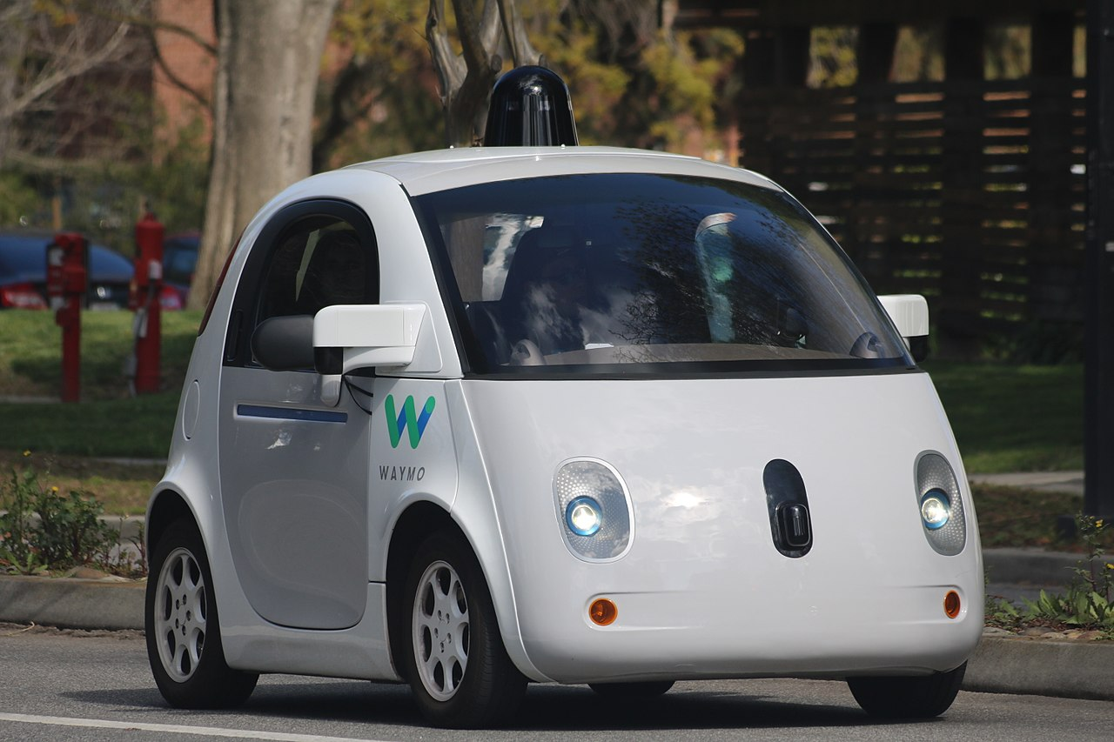
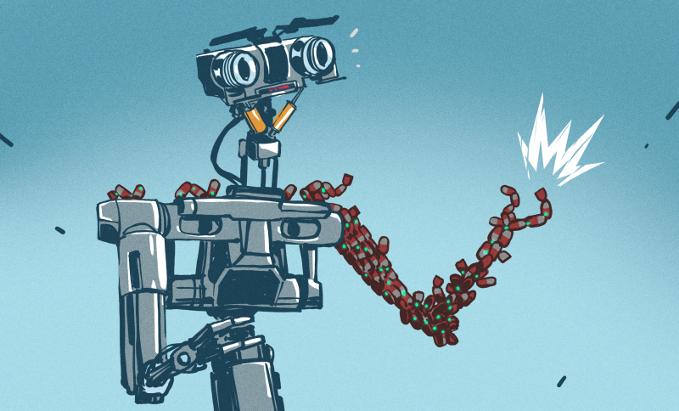

Motivation
Business related (Why Reinforcement Learning ?)
Most exciting field in Machine Learning
Market size of 7.35 Billion USD
Wide Range of Applications
This Photo by Unknown Author is licensed under CC BY-SA
This Photo by Unknown Author is licensed under CC BY-SA-NC
This Photo by Unknown Author is licensed under CC BY

Slide 7
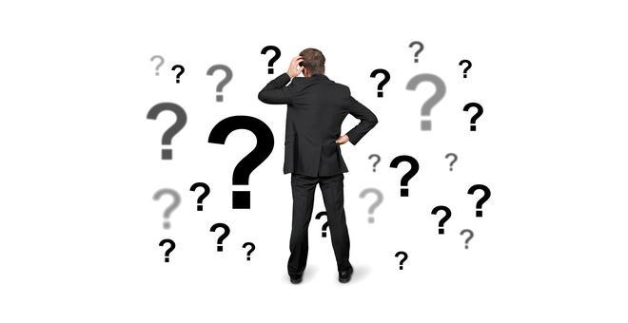
Problem Statement
Setup guidelines for the choice of algorithms
For two RL algorithms
Deep Q Network
Tabular Method
Uses Neural Network as Function Approximator
Policy Gradient
Approximation Method
Iterates over Policies to find the best
Also Uses Neural Network as Function Approximator
Judge Agent’s behavior and learning performance
On different control system environments
This Photo by Unknown Author is licensed under CC BY-NC

Slide 8


Research Methodolgy Research Tools and Solution Strategy
Create the learning data
Conduct Experiments
on CartPole-v1
on LunarLander-v2
Build Agents using the two mentioned RL algorithms
with Tensorflow
Environments Offered by OpenAI gym
Benchmark tools to test RL algorithms
This Photo by Unknown Author is licensed under CC BY-SA
This Photo by Unknown Author is licensed under CC BY-SA

Slide 9
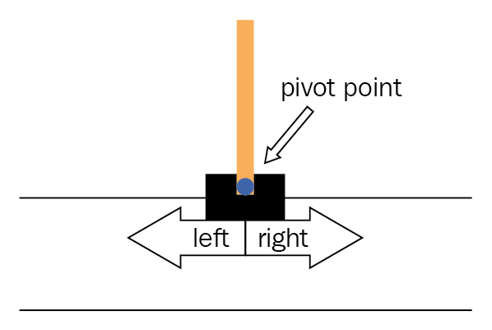
Experimental Setup Cartpole-v1
Pole is attached by an un-actuated joint to a cart
Cart moves along a frictionless track
Goal – Prevent Pole from Falling over
Environment specifications
Actions space – 2 (left or right)
Observations space – 4
Reward - 1 points per step
Episode Termination
Pole Angle > 15 deg
Episode last more than 500 steps
This Photo taken from https://www.oreilly.com

Slide 10
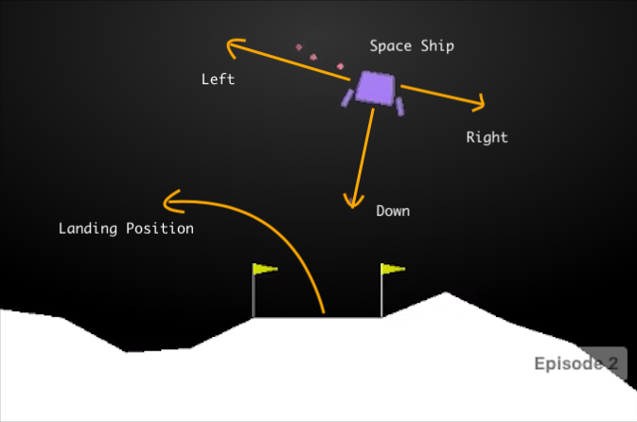
Experimental Setup LunarLander-v2
Vehicle starts from the top of the screen
Landing pad is always at coordinates (0,0)
Goal – Land the vehicle on the target
Environment specifications
Actions space – 4 (L | R | Main | nothing)
Observations space – 8
Rewards = 100..140 (top of the screen to landing pad)
Episode Termination
Lander crashes , rests
Episode last more than 1000 steps
This Photo taken from https://www.miro.medium.com

Slide 11

Experimental Setup Evaluation Criterion
Agent‘s Performance Metrics
Episodes required for sufficient training
Average Steps to solve the problem
Agent‘s “Goodness“ to acheive the target
Capture agent‘s Behaviour
On multiple test instances of enviroment
This Photo by Unknown Author is licensed under CC BY-SA-NC

Slide 12
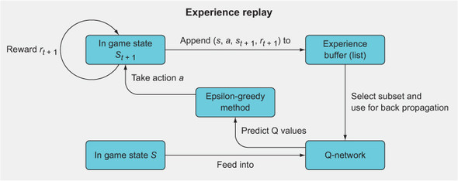
DQN Agent Working Mechanism of Algorithm
This Photo was taken from manning.com

Slide 13
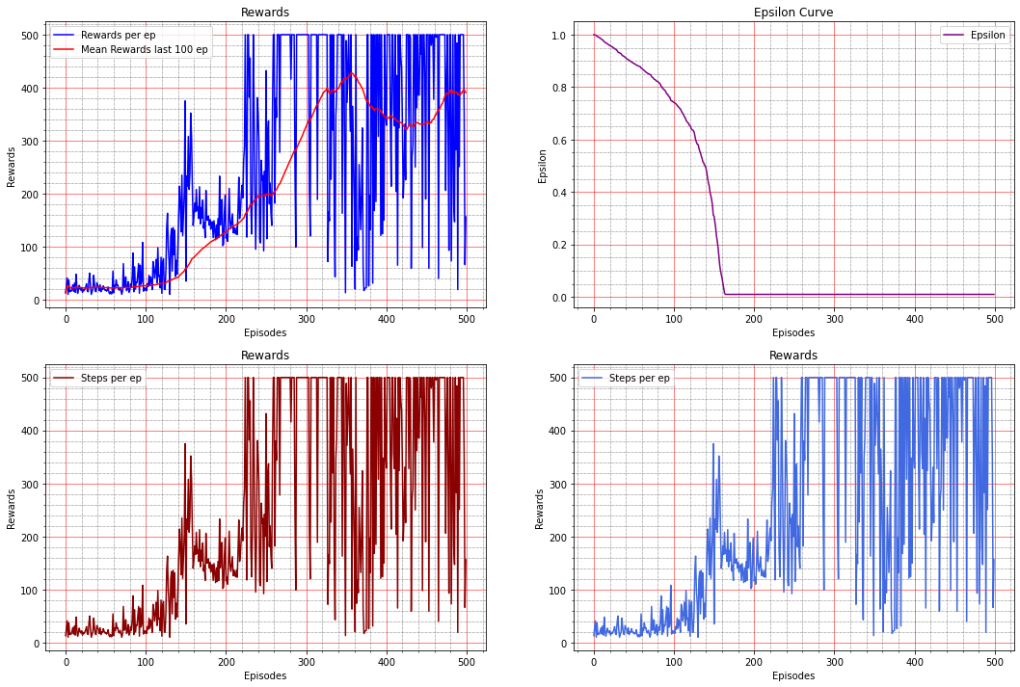
Results and Current Status Learning curve and Metrics of Cartpole-v1‘s DQN Agent
This Photo taken from our Jupyter Notebook

Slide 14
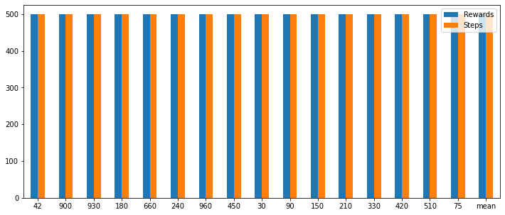
Results and Current Status Performance on Test instances of Cartpole-v1
This Photo taken from our Jupyter Notebook

Slide 15
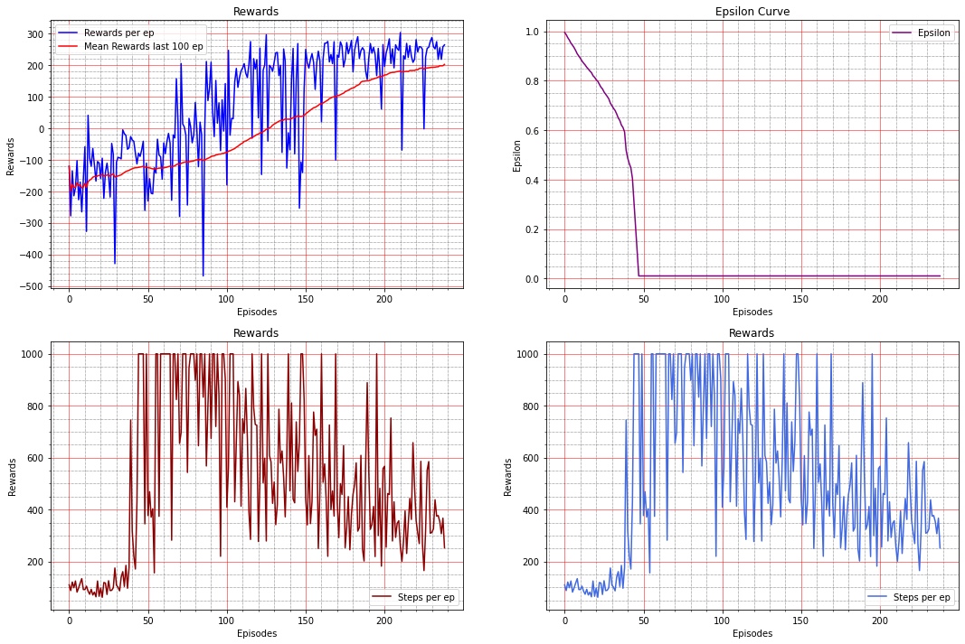
Results and Current Status Learning curve and Metrics of LunarLander-v2 DQN Agent
This Photo taken from our Jupyter Notebook

Slide 16
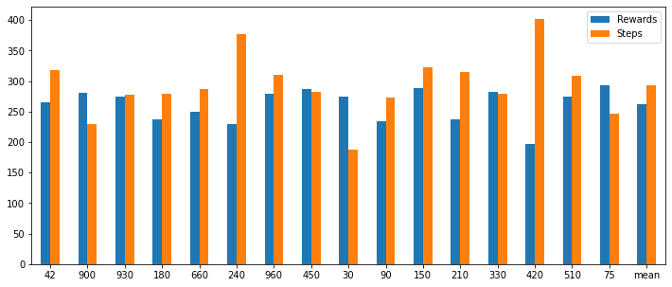
Results and Current Status Performance on Test instances of LunarLander-v2
This Photo taken from our Jupyter Notebook

Slide 17
Results and Current Status Influencial Factors on DQN Agent
Initial Parameters of the Model
Initialization seeds
Catastrophic Forgetting by the Model
Other Hyperparameters of Agent
Number of model Layers
Epsilon Decay Rate
Learning Rate
Discount Factor
Train to determine ‘suitable’ Hyperparameters

Slide 18
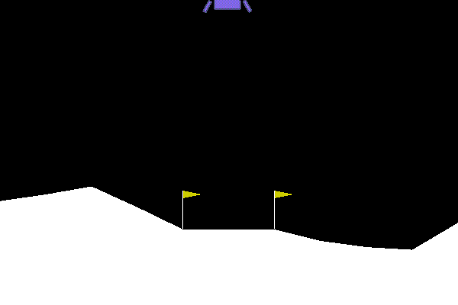
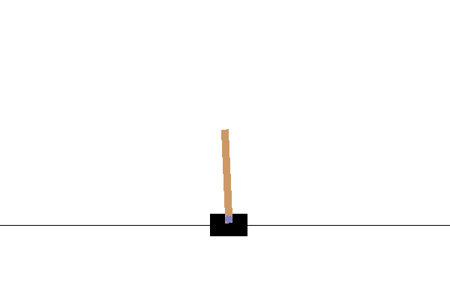
Results and Current Status Outputs of Unadequately trained DQN Agents
GIF from our Jupyter Notebook

Slide 19
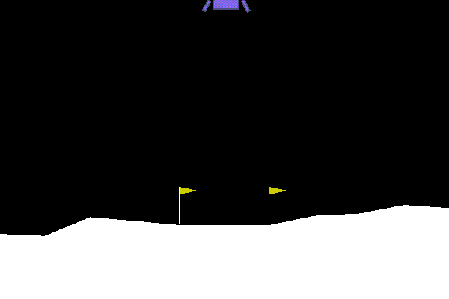
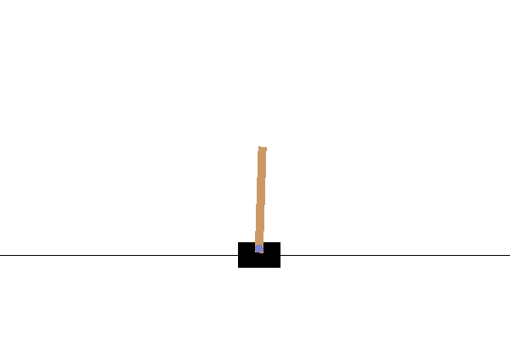
Results and Current Status Outputs of Adequately trained DQN Agents
GIF from our Jupyter Notebook

Slide 20
Outlook
DQN Agent
LunarLander Implementation
Policy Gradient
Results
Policy Gradient
LunarLander Implementation
Results
Cartpole Implementation
Determine Results
Master-Thesis
Kolloquium
Interpretation
Results
Submission und Presentation
Comparison of Results
Setup Guidelines
Build Agent
Build Agent
Cartpole Implementation
November
December
Dec. – Jan.
Jan. – Feb.
October

Slide 21
Thank you for your attention
Notes:
Fragen:

